Slide 1
BLOCKCHAIN CONSENSUS SIMULATOR
CANAY TAŞAR
HANİFE HAZEL GÜLLER
M.MUSTAFA ERCAN
YAĞMUR EBRAR ÖZYURT

Slide 2

BLOCKCHAIN CONSENSUS SIMULATOR
DEFINITION:
Blockchain simulator creates a test environment that allows us to test the effects of creating a blockchain using different methods through trial and error.
MAIN FEATURES:
The user will have features such as speeding up and stopping the simulation and slowing backwards or going backwards or forwards.

Slide 3
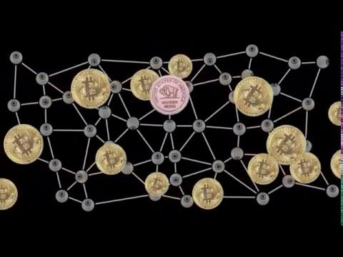

Network & Consensus

Slide 4
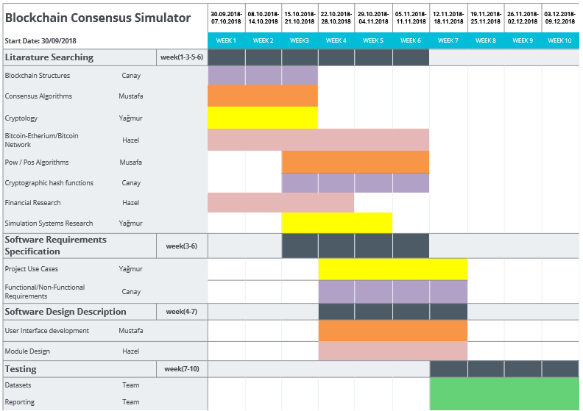
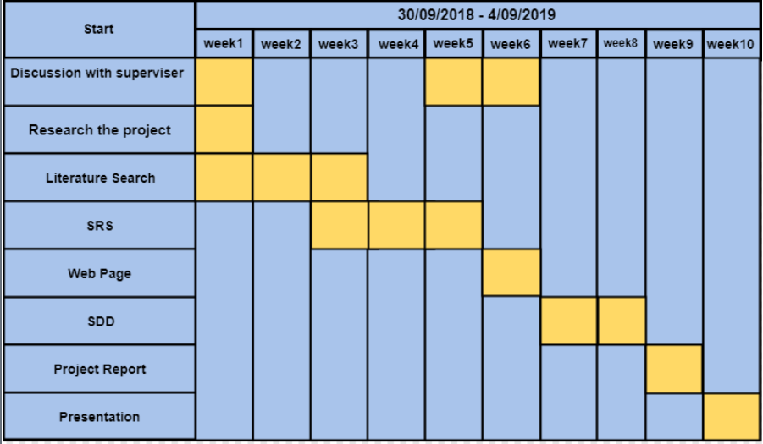
Work Plan & Activity Plan

Slide 5
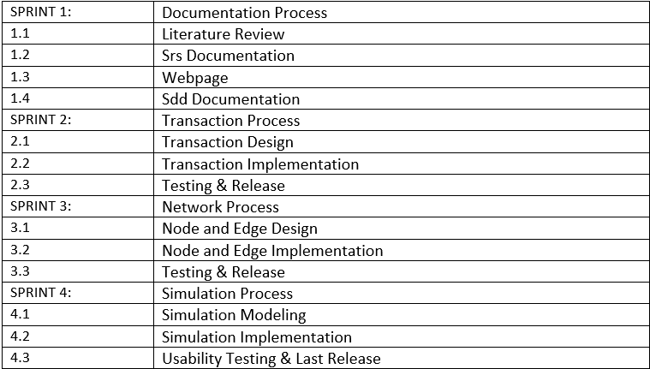
Scrum Table

Slide 6
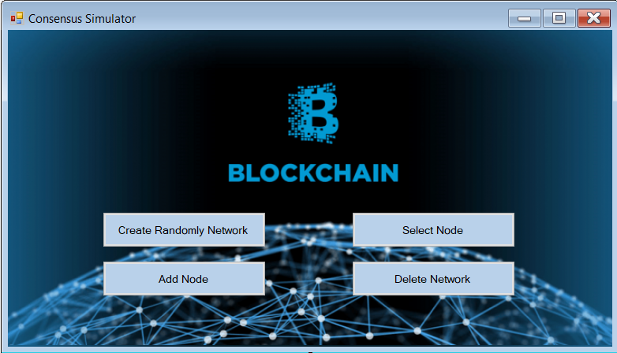
Design Concept

Slide 7
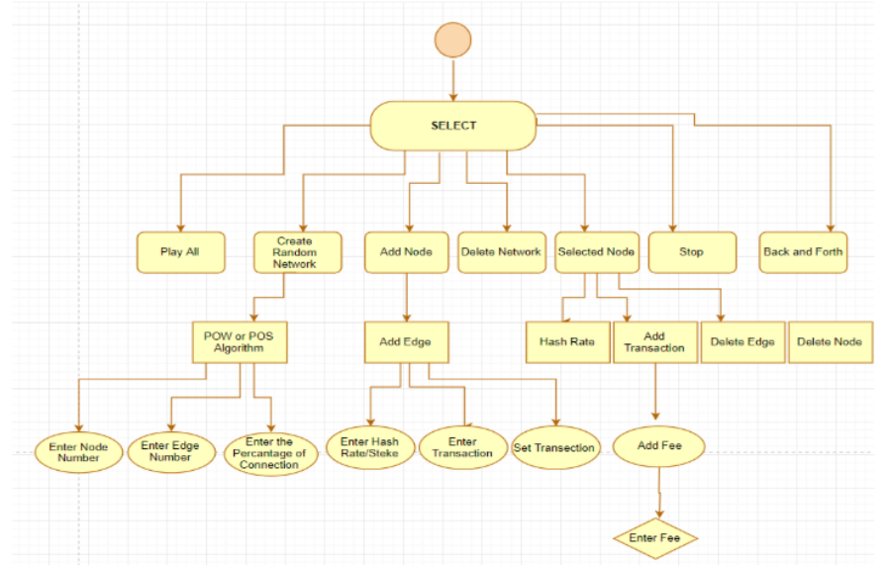
Activity Diagram

Slide 8
Similar Projects
Ethereum Tester: It is an open-source testing library available as a Github repo. Its setup is pretty easy with a manageable API support for various Testing requirements.
BitcoinJ: It is a Java-based framework built for Bitcoin-based apps that enables you to interact with the real BTC network and various testing activities. In order to use it, you don’t have to download the standard BTC Core files from Bitcoin.com. You can even approach a user forum in case you need clarification or are facing hiccups in the testing process. It is an open network available for assistance.
Populus: This framework has the testing functionality of Ethereum embedded in the form of a set of features for test contract deployment. It’s developed around the py. test framework. Hence, it is relatively easy to implement.
Truffle: It’s a commonly referred name for Ethereum developers, which brings in good testing features, such as automated contract testing. The framework holds capabilities beyond just testing functionality within the Blockchain application.
Embark: It is a testing framework that focuses on developing decentralized applications (dApps) that run on various systems or nodes. It has integrations with Ethereum blockchain, IPFS, and a decentralized communication platforms such as Whisper and Orbit.

Slide 9
Problem
All the factors that can be encountered in the real application cannot be reviewed and simulated. It is simulated using only basic principles. And this is lowering the reality of our simulation.

Slide 10
REFERENCES
[1] M. S. Paul, “Hyperledger - Chapter 1 | Blockchain Foundation – The Startup – Medium,” Medium, 23-Apr-2018. [Online]. Available: https://medium.com/swlh/hyperledger-chapter-1-foundation-7ad5bd94d452. [Accessed: 08-Nov-2018].
[2] GCSE Bitesize: Advantages and disadvantages of simulation,” BBC. [Online]. Available: http://www.bbc.co.uk/schools/gcsebitesize/ict/modelling/1computersimulationrev3.shtml. [Accessed: 07-Nov-2018].
[3] Introduction. [Online]. Available: http://web.cs.mun.ca/~donald/msc/node4.html. [Accessed: 07-Nov-2018].
[4] ACMSoftware.(2018).ScrumNedir?.[online]Availableat: http://www.acm-software.com/scrum/[Accessed 23 Nov. 2018].

Slide 11


